Slide 1
Week 2(10.9-10.15) Progress Report
Siyu Zhang
10.15

Slide 2
Update: Plan for the project
Goal: Designed for showing the strength of ray tracing and customizing a set of attributes particularly for food rendering
Topic: Ray Tracing
Still related to ray tracing but not really GPU ray tracer
Cycles in Blender is a quite powerful path tracer renderer
Understand Ray Tracing algorithms and Cycles engine implementation
Customize Ray Tracing particularly for food models
Build a scene which is suitable for showing ray tracing property
San Miguel Scene – discard this plan
Too complicated – time consuming for rendering
Besides donuts, other models of food should be added
Plan to modeling the grilled fish in a iron plate

Slide 3
Ray Tracing Strength and Choice of Models/Scenes
Photo-realistic
Material and Texture representations:
Liquid: requires plenty of transmission and reflection lighting rays to look more realistic
Soup in the plate of grilled fish
Glossy metal:
The plate of the grilled fish

Slide 4
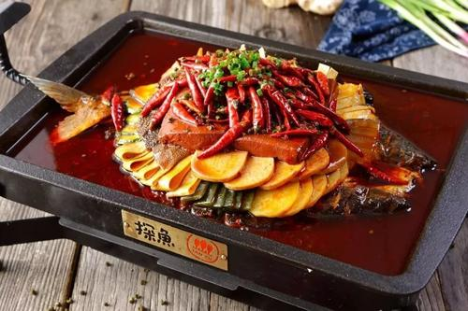
Liquid: soup and oil
Glossy Metal:
Iron Plate

Slide 5
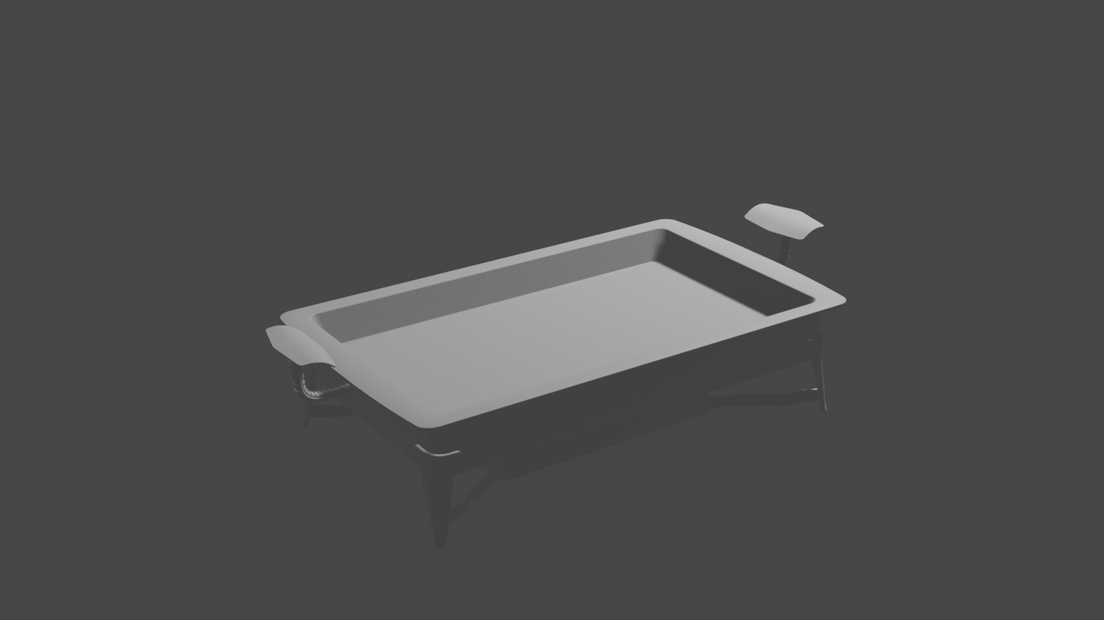
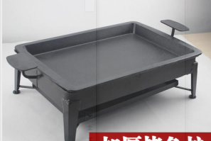

Slide 6
Takeaways for this week
Blender Add-on
Blender directory structures
python scripting

Slide 7
Plan for the next week
Start modeling the scene
[Finished / In progress] Donuts and Coffee (probably need to change the beverage later - coke would be better?)
[In progress] Grilled Fish modeling

